Slide 1
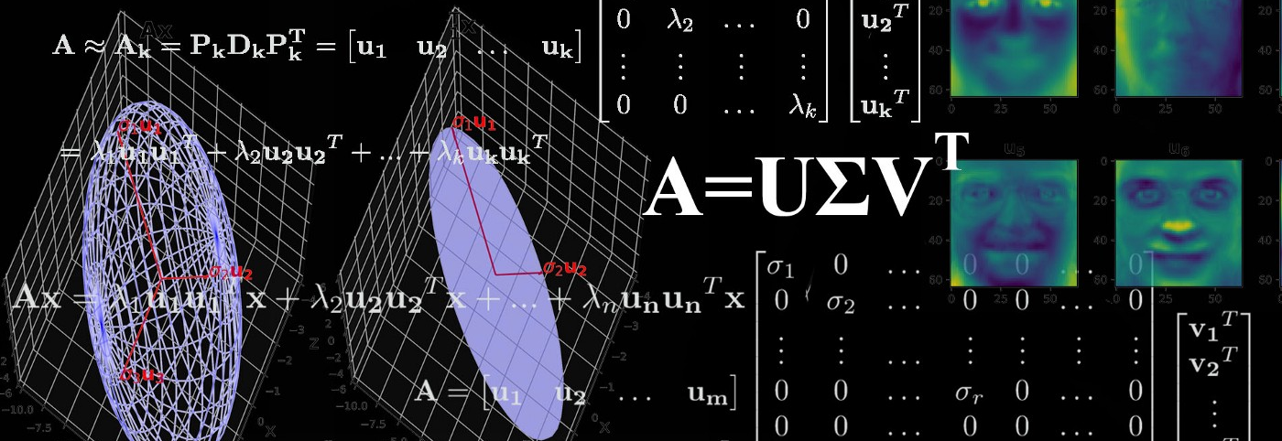
SINGULAR VALUE DECOMPOSITION
BY NETALIYEVA YELDANA

Slide 2
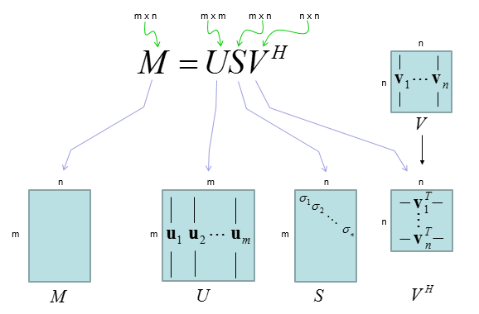
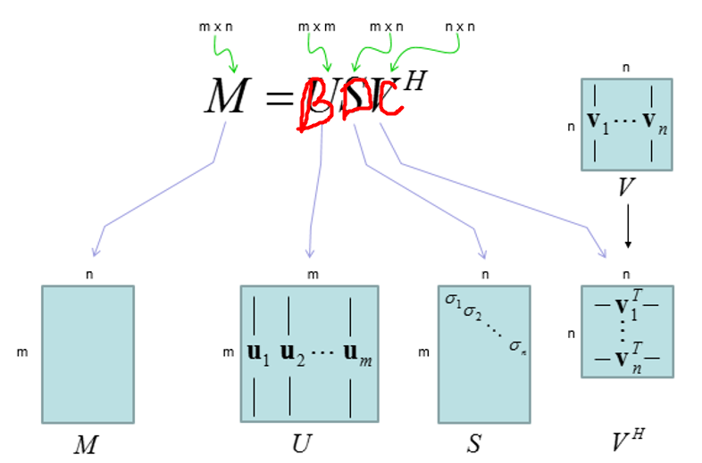
What is SVD

Slide 3

PLAN OF PRESENTATION
GUI
ALGORITHM
SELF-STUDY

Slide 4
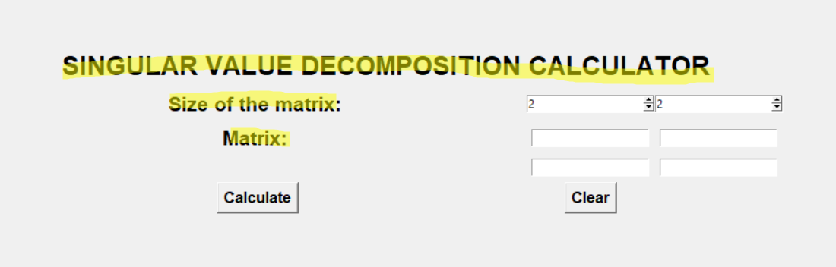
Main Frame Function
def main_frame(self):
self.frame = Frame(self.window)
self.frame.pack()
#Labels
title_label = Label(self.frame, text = "SINGULAR VALUE DECOMPOSITION CALCULATOR", font=("Arial Bold", 20))
size_label = Label(self.frame, text = "Size of the matrix: ", font=("Arial Bold", 16))
matrix_label = Label(self.frame, text = "Matrix: ", font=("Arial Bold", 16))
Label(self.frame).grid(row=0, column=0, padx=280, pady=60)
title_label.grid(row=1, column=0, columns = 4, pady = 3)
size_label.grid(row = 2, column = 0, pady = 3)
matrix_label.grid(row = 3, column = 0, pady = 3)

Slide 5
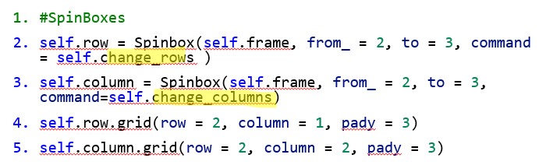
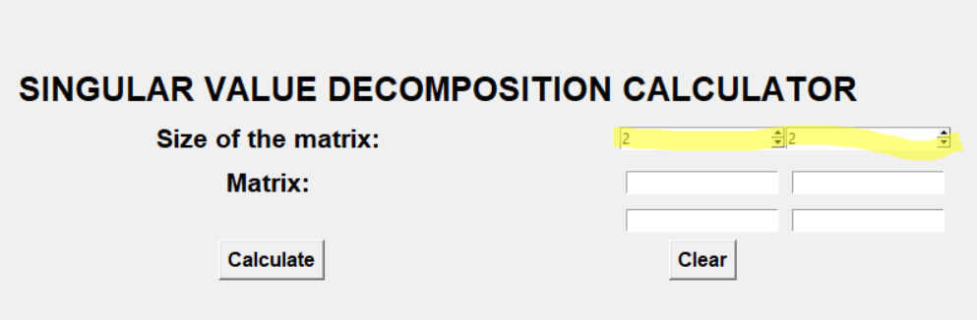
Spin Boxes

Slide 6
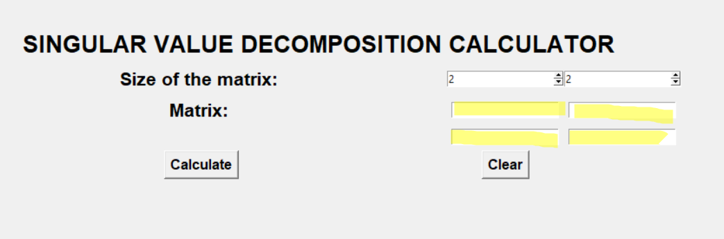
Entries
#Entry
self.A00 = Entry(self.frame)
self.A00.grid(row = 3, column = 1, pady = 3)
self.A01 = Entry(self.frame)
self.A01.grid(row = 3, column = 2, pady = 3)
self.A10 = Entry(self.frame)
self.A10.grid(row = 4, column = 1, pady = 3)
self.A11 = Entry(self.frame)
self.A11.grid(row = 4, column = 2, pady = 3)
self.entry_boxes = [self.A00, self.A01, self.A10, self.A11]

Slide 7
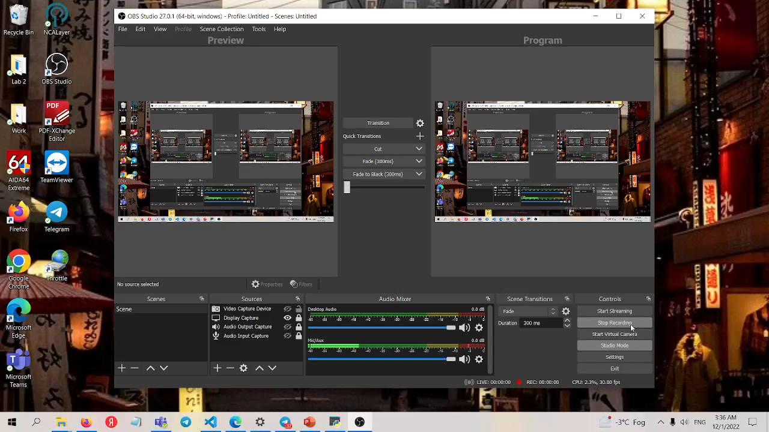
Changing Dimensions of Input Matrix

Slide 8
Changing rows
def change_rows(self):
self.row_num = self.row.get()
self.column_num = self.column.get()
if self.row_num == "3":
self.A20 = Entry(self.frame)
self.A20.grid(row = 5, column = 1, pady = 3)
self.A21 = Entry(self.frame)
self.A21.grid(row = 5, column = 2, pady = 3)
self.entry_boxes.append(self.A20)
self.entry_boxes.append(self.A21)
elif self.row_num == "2":
try: a = self.A20 in self.entry_boxes and self.A21 in self.entry_boxes
except: pass
else:
if self.A20 in self.entry_boxes and self.A21 in self.entry_boxes:
self.entry_boxes.remove(self.A20)
self.entry_boxes.remove(self.A21)
self.A20.destroy()
self.A21.destroy()
try: a = self.A22 in self.entry_boxes
except: pass
else:
if self.A22 in self.entry_boxes:
self.entry_boxes.remove(self.A22)
self.A22.destroy()
if self.row_num == "3" and self.column_num == "3":
self.A22 = Entry(self.frame)
self.A22.grid(row = 5, column = 3, pady = 3)
self.entry_boxes.append(self.A22)

Slide 9
Changing columns
def change_columns(self):
self.row_num = self.row.get()
self.column_num = self.column.get()
if self.column_num == "3":
self.A02 = Entry(self.frame)
self.A02.grid(row = 3, column = 3, pady = 3)
self.A12 = Entry(self.frame)
self.A12.grid(row = 4, column = 3, pady = 3)
self.entry_boxes.insert(2, self.A02)
self.entry_boxes.insert(5, self.A12)
elif self.column_num == "2":
try: a = self.A02 in self.entry_boxes and self.A12 in self.entry_boxes
except: pass
else:
if self.A02 in self.entry_boxes and self.A12 in self.entry_boxes:
self.entry_boxes.remove(self.A02)
self.entry_boxes.remove(self.A12)
self.A02.destroy()
self.A12.destroy()
try: a = self.A22 in self.entry_boxes
except: pass
else:
if self.A22 in self.entry_boxes:
self.entry_boxes.remove(self.A22)
self.A22.destroy()
if self.row_num == "3" and self.column_num == "3":
self.A22 = Entry(self.frame)
self.A22.grid(row = 5, column = 3, pady = 3)
self.entry_boxes.append(self.A22)

Slide 10

Outputting results

Slide 11
Scroll bar
self.scroll_bar = Scrollbar(self.frame, orient = "vertical") # Create a scroll bar
self.text_widget = Text(self.frame, yscrollcommand=self.scroll_bar.set) # Create a text_widget
self.scroll_bar.grid(row = 7, column = 4, rowspan = 4) # Pack the scroll bar
self.scroll_bar.config(command=self.text_widget.yview) # Attach the scrollbar with the text widget
self.text_widget.grid(row = 7, column = 0, rowspan = 4, columnspan = 4) # Pack the text widget
self.text_widget.insert(END, self.to_print)# Insert text into the text widget

Slide 12
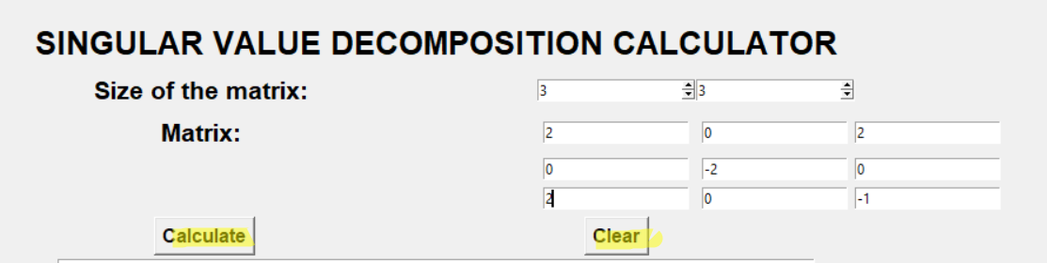
Buttons
#Buttons
self.calculate = Button(self.frame, text = "Calculate", font=("Arial Bold", 12), command = self.get_matrix).grid(row = 6, column = 0, pady =3)
self.clear = Button(self.frame, text = "Clear", font=("Arial Bold", 12), command = self.clear_page).grid(row = 6, column = 1, pady =3)

Slide 13
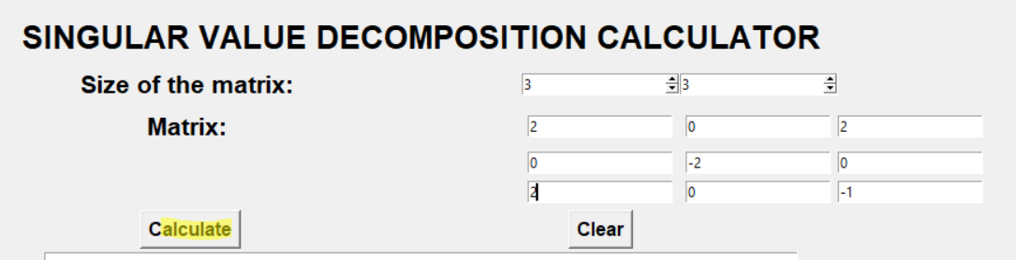
Buttons calculate
def get_matrix(self):
self.row_num = self.row.get()
self.column_num = self.column.get()
matrix = list()
for i in range(len(self.entry_boxes)):
matrix.append(self.entry_boxes[i].get())
self.A = np.array(np.array(matrix).reshape(int(self.row_num), int(self.column_num)), dtype = float)
self.SVD()

Slide 14
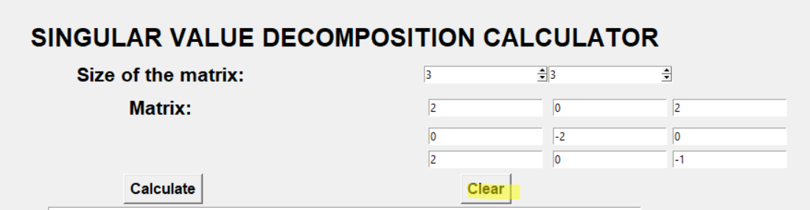
Buttons clear
def clear_page(self):
for i in range(len(self.entry_boxes)):
self.entry_boxes[i].delete(0, END)
self.to_print = ""
self.text_widget.delete(1.0, END)

Slide 15
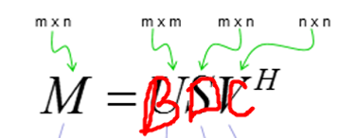
SVD Function
def SVD(self):
self.D_find()
self.C_find()
self.B_find()

Slide 16
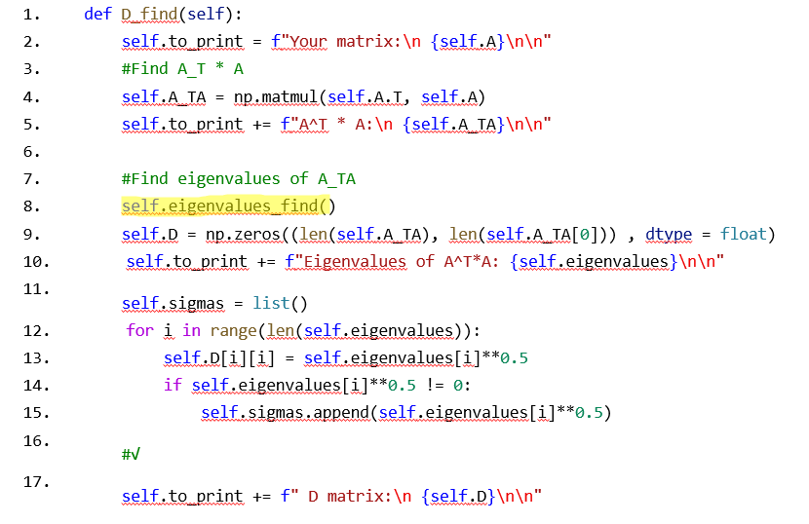
1. D_find() function

Slide 17
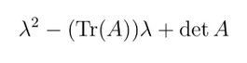
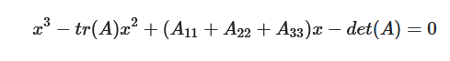
1.1 Eigenvalues_find() function 1.1.1 Finding characteristic polynomial
def eigenvalues_find(self):
if len(self.A_TA) == 2:
a = 0
b = -1
c = sum(np.diag(self.A_TA))
d = -1 * self.det(self.A_TA)
ch_pol = f"{b}x² + ({c})x + ({d})"
elif len(self.A_TA) == 3:
a = -1
b = sum(np.diag(self.A_TA))
c = -1 * sum([self.det(self.A_TA[:2, :2]), self.det(self.A_TA[1:3, 1:3]), self.det(self.A_TA[::2, ::2])])
d = self.det(self.A_TA)
ch_pol = f"{a}x³ + ({b})x² + ({c})x + ({d})"
self.to_print += f"Characteristic polynomial: {ch_pol}\n\n"

Slide 18
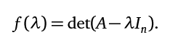
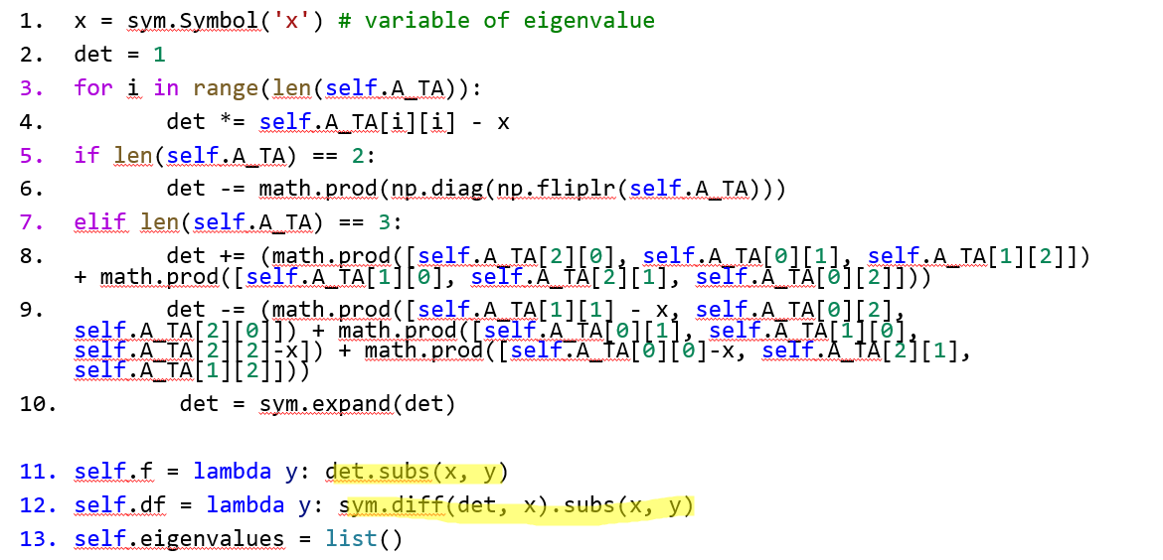
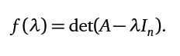

Slide 19
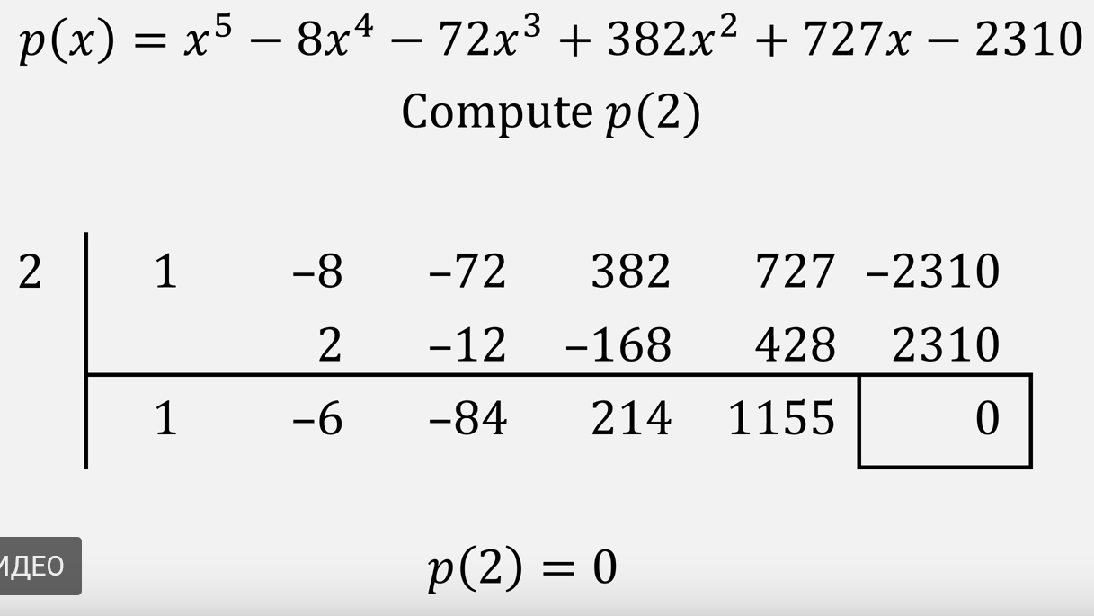
1.1 Eigenvalues_find() function 1.1.2 Solving characteristic polynomial 1.1.2.1 Algorithm
Main strategy → Use Horner’s method to decompose equation to square
https://www.youtube.com/watch?v=zEvfkSuPqWk&feature=youtu.be
Condition for Horner’s method:
Find at least one root of equation
Solution → Newton-Raphson Method
https://brilliant.org/wiki/newton-raphson-method/

Slide 20
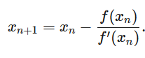
1.1 Eigenvalues_find() function 1.1.2 Solving characteristic polynomial 1.1.2.2 Newton_Raphson() function
def newtonRaphson(self, x):
h = self.f(x) / self.df(x)
while abs(h) >= 0.0000001:
h = self.f(x)/self.df(x)
# x(i+1) = x(i) - f(x) / f'(x)
x = x - h
return round(x)
x0 = 0.75 #Initial guess
self.eigenvalues.append(float(self.newtonRaphson(x0)))

Slide 21
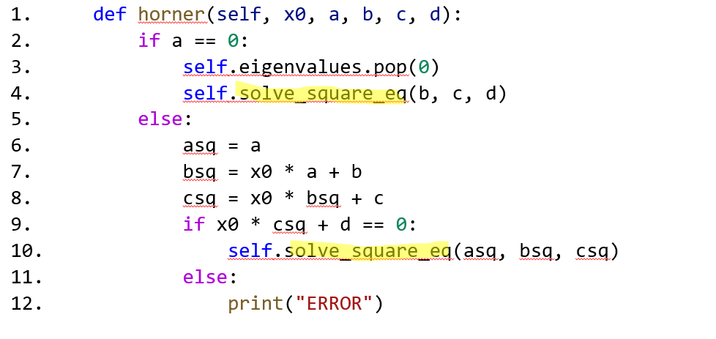
1.1 Eigenvalues_find() function 1.1.2 Solving characteristic polynomial 1.1.2.3 Horner’s method

Slide 22
1.1 Eigenvalues_find() function 1.1.2 Solving characteristic polynomial 1.1.2.4 Solving Square equation
def solve_square_eq(self, a, b, c):
D = b**2 - 4 * a * c
x1 = (-b + D**0.5)/2*a
self.eigenvalues.append(x1)
x2 = (-b - D**0.5)/2*a
self.eigenvalues.append(x2)

Slide 23
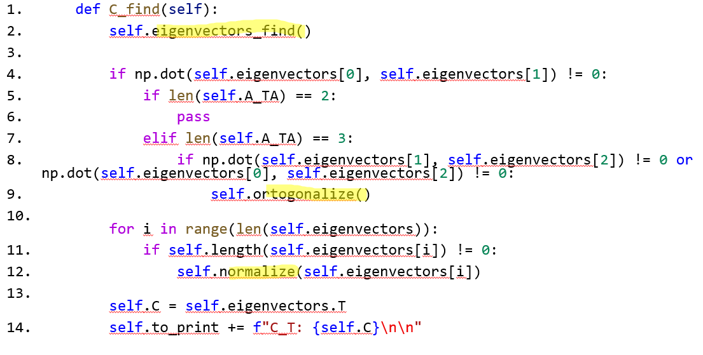
2. C_find() function

Slide 24
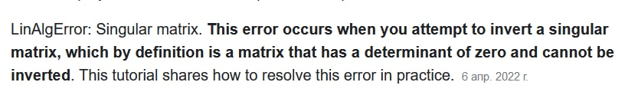
2.1 Finding eigenvectors 2.1.2 Theory&problems
Methods to solve SLE:
Method of inverse matrix
Cramer’s method
Gauss method
Problem :
Zero Determinant matrix → Free Variable

Slide 25
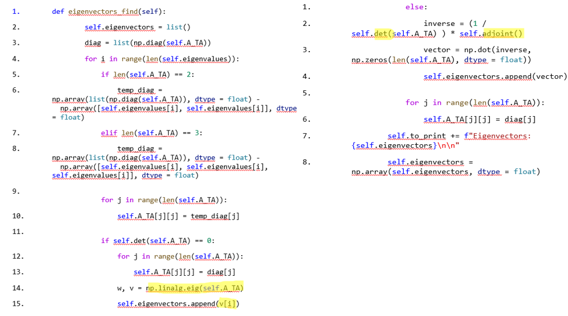
2.1 Finding eigenvectors 2.1.2 Function

Slide 26
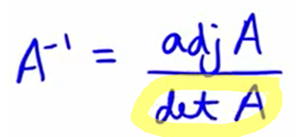
2.1 Finding eigenvectors 2.1.2.1 Determinant of matrix
def det(self, A):
det = 0
det += math.prod(np.diag(A))
det -= math.prod(np.diag(np.fliplr(A)))
if len(A) == 3:
det += (math.prod([A[2][0], A[0][1], A[1][2]]) + math.prod([A[1][0], A[2][1], A[0][2]]))
det -= (math.prod([A[0][1], A[1][0], A[2][2]]) + math.prod([A[0][0], A[2][1], A[1][2]]))
return det
return det

Slide 27
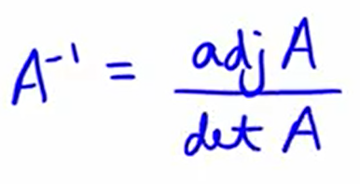
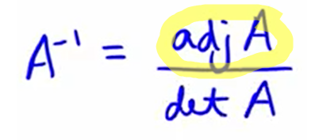
2.1 Finding eigenvectors 2.1.2.2 Adjoint Matrix
def adjoint(self):
temp = list()
if len(self.A_TA) == 2:
temp.append(self.A_TA[1][1])
temp.append(-1 * self.A_TA[1][0] )
temp.append(-1 * self.A_TA[0][1] )
temp.append(self.A_TA[0][0] )
return np.array(np.array(temp).reshape(2, 2), dtype = float)
elif len(self.A_TA) == 3:
temp.append(self.det(self.A_TA[1:3, 1:3]))
temp.append(-1 *self.det(self.A_TA[::2, ::2]))
temp.append(self.det(self.A_TA[1:3, :2]))
temp.append(-1*self.det(self.A_TA[:3:2, 1:3]))
temp.append(self.det(self.A_TA[:3:2, :3:2]))
temp.append(-1 * self.det(self.A_TA[:3:2, :2]))
temp.append(self.det(self.A_TA[:2, 1:3]))
temp.append(-1 * self.det(self.A_TA[:2, :3:2]))
temp.append(self.det(self.A_TA[:2, :2]))
return np.array(np.array(temp).reshape(3, 3), dtype = float)

Slide 28
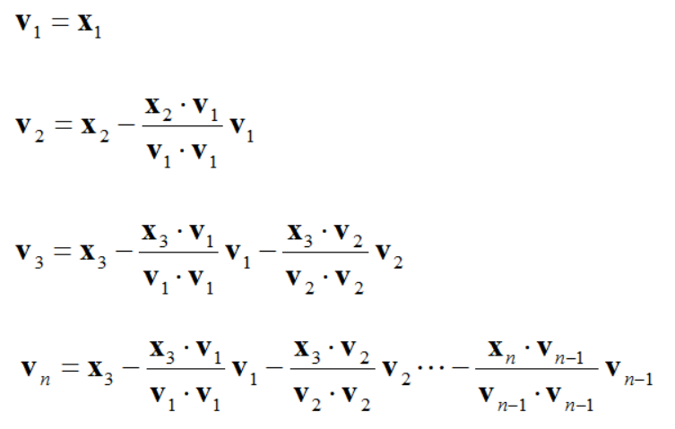
2. C_find() function 2.2.1 Ortogonalization Theory
Gram-Shmidt procedure

Slide 29
2. C_find() function 2.2.2 Ortogonalization Function
def ortogonalize(self):
k = list()
for i in range(1, len(self.eigenvectors)):
temp = np.dot(self.eigenvectors[i], self.eigenvectors[i-1])/np.dot(self.eigenvectors[i-1], self.eigenvectors[i-1])
k.append(temp)
for j in range(len(k)):
self.eigenvectors[i] -= k[j] * self.eigenvectors[j]

Slide 30
2. C_find() function 2.3 Normalization Function
def normalize(self, v):
length_v = 0
for i in range(len(v)):
length_v += v[i]**2
length_v = length_v ** 0.5
for i in range(len(v)):
v[i] = v[i]/length_v

Slide 31
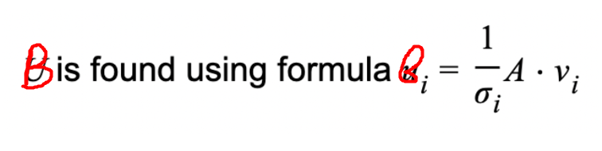
3. B_find() function 3.1 Theory

Slide 32
3. B_find() function 3.2 Function
def B_find(self):
temp = list()
for i in range(len(self.sigmas)):
a = 1/self.sigmas[i]
matrix = a * self.A
vector = np.matmul(matrix, self.eigenvectors[i])
temp.append(vector)
self.B = np.array(temp, dtype = float)
self.to_print += f"B: {self.B}\n\n"

Slide 33
Self-study
GUI
Scroll bar
Spin boxes
Practical implementation of mathematical knowledge
OOP

Slide 34

Thank you for your attention

